Slide 1
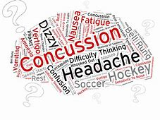
Concussions in Pediatrics
Katie Weems, PT
Carrie Tingley Hospital

Slide 2
Disclosures
Katie Weems, PT – None

Slide 3
Objectives
Understand NM law regarding sport concussion
Understand how to diagnose a concussion
Understand treatment done by PT
Understand return to learn model
Understand return to play model

Slide 4
MTBI Definition (ace, G. Gioia & M. Collins, 2006 v2)
A concussion (or mild traumatic brain injury (MTBI)) is a complex pathophysiologic process affecting the brain, induced by traumatic biomechanical forces secondary to direct or indirect forces to the head. Disturbance of brain function is related to neurometabolic dysfunction, rather than structural injury, and is typically associated with normal structural neuroimaging findings (i.e., CT scan, MRI).
Concussion may or may not involve a loss of consciousness (LOC).
Concussion results in a constellation of physical, cognitive, emotional and sleep-related symptoms.
Symptoms may last from several minutes to days, weeks, months or even longer in some cases.

Slide 5
Pediatric Concussion Facts
Between 1.7 and 3 million sports- and recreation-related concussions happen each year. Around 300,000 are football-related.
5 of 10 concussions go unreported or undetected.
2 in 10 high-school athletes who play contact sports — including soccer and lacrosse — will suffer a concussion this year.
Girls' soccer sees the second-most concussions of all high school sports. Girls’ basketball sees the third most.
Falls (50%) is the highest cause of brain injury, followed by assault (25%) in children aged 0-14 years (CDC)
TBI is the leading cause of death and disability in children 0-4 years and adolescents (15-19 years) (CDC, 2015) and 80% of TBI are mTBI (CDC, 2003)
Stats from UPMC – Concussion clinic

Slide 6
NMAA Athletic Program Requirements Senate Bill 38; Concussion Law Grades 6 - 12
22-13-31.1 NMSA 1978; Section G:
“brain injury" means a body-altering physical trauma to the brain, skull or neck caused by, but not limited to, blunt or penetrating force, concussion, diffuse axonal injury, hypoxia anoxia or electrical charge

Slide 7
RETURN TO PLAY GUIDELINES UNDER NEW MEXICO SENATE BILL 38 (2017)
Remove athlete immediately from activity when signs/symptoms of a concussion are present.
Athletes must not return to full activity prior to a minimum of 240 hours (10 days).
Athletes must be released to participation by an appropriate medical professional before returning.
- MD, DO, PA, CNP, PT, Licensed Psychologist, Licensed Athletic Trainer (as per Senate Bill 38)
School districts are required to develop head injury protocols (guidelines).
https://www.nmact.org/file/Concussion_Info_ADs.pdf

Slide 8
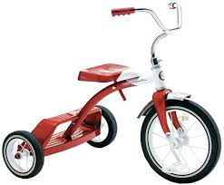
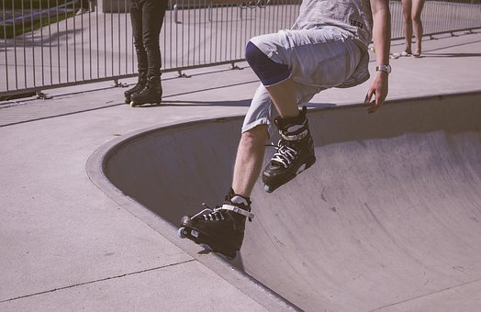
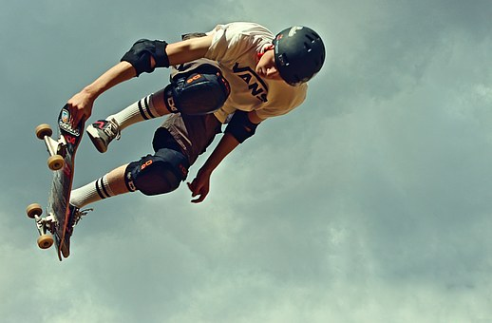
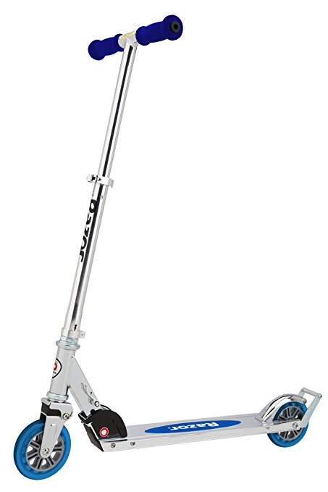
NM Helmet Law
An Ounce of Prevention Beats a Pound of Cure
All children up to the age of 18 years must wear a helmet while riding a:
Scooter, Bicycle, Tricycle, and Skateboard and using roller skates

Slide 9
University of NEW MEXICO RESEARCH
Bottom Line: More concussions in PE than sports, so be alert to a wide range of youth athletic activities!

Slide 10
Undiagnosed Concussion
Patients may present to us as medical professionals without a clear diagnosis of concussion:
Child- playground injury - falls
Assault
Patient with multiple trauma from MVC
Those that are unreported
Child adolescent sports injury
Be cognizant of concussion profile, probe history thoroughly- make referrals!

Slide 11
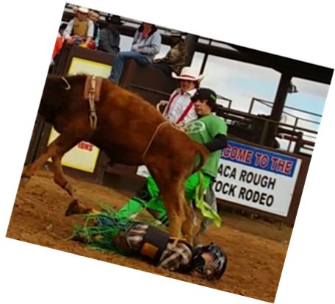
Symptomatic Recovery Period
No exercise (24-48 hours only!)
Decreased school activity/hours (based on symptoms)
Avoid decompensation
Role of added stressors
No 2 concussions are the same
PATIENT EDUCATION!!!
Silverberg and Iverson; J head Trauma Rehabil 2012

Slide 12
When to Refer OUT to Rehab
*Vidal PG,Goodman AM,Colin A, Leddy JL, Grady MF.Rehabilitation Strategies for Prolonged Recovery in Pediatric and Adolescent Concussion. Pediatrics. 2012:41:9 (1-6)

Slide 13
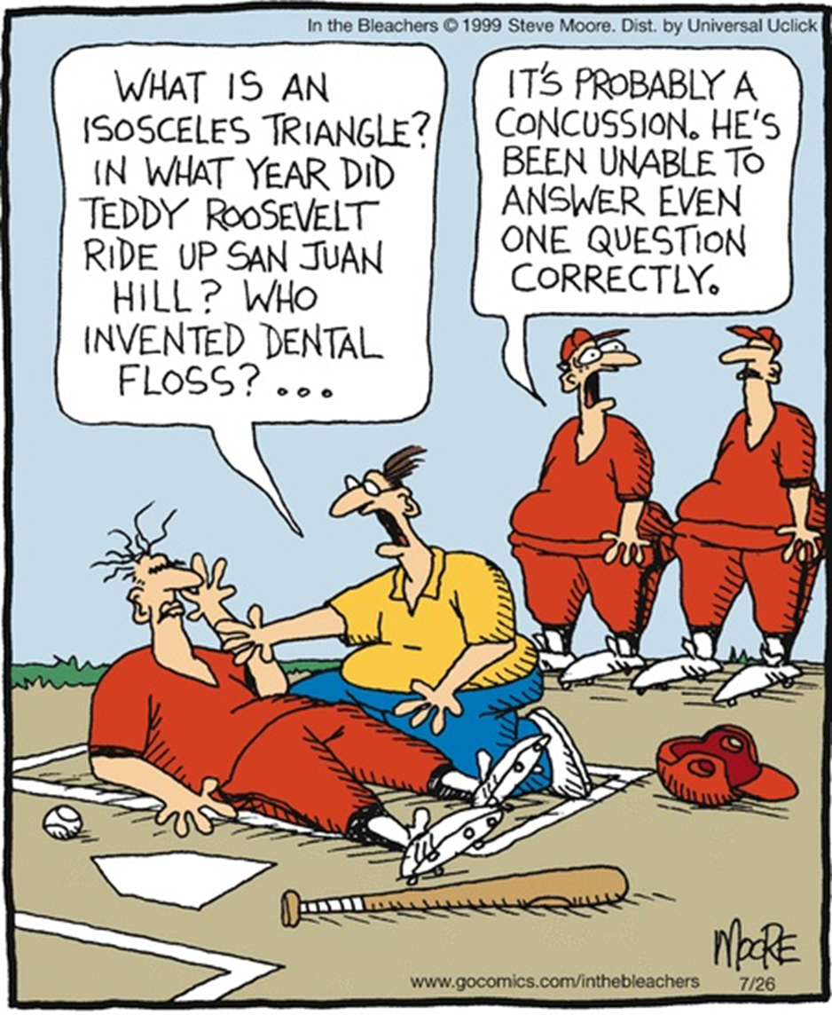
PT Evaluation
Subjective/ History/ Observation
Oculomotor
Musculoskeletal
Vestibular (Day 4/5)
Balance/ Gait (Day 4/5)
Cardiovascular- Leddy Protocol (Day 5/6)
Functional Testing / Cognitive Tasking/ Multi tasking

Slide 14
Post-Concussion Examination
Subjective/ History/Observation

Slide 15
SYMPTOMS
Somatic
headaches, nausea, vomiting, balance and or visual problems, dizzy spells, and issues with light sensitivity and noise
Emotional
sadness to the point of depression (even suicide), nervousness, and irritability
Sleep disturbance
Sleeping more or less than usual and trouble falling asleep
Cognitive
Difficulty concentrating, troubles with memory, feeling mental slow or feeling in a FOG

Slide 16
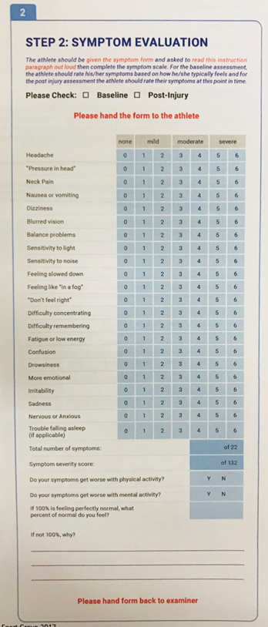
SYMPTOM CHECKLIST
Find one that works for you!

Slide 17
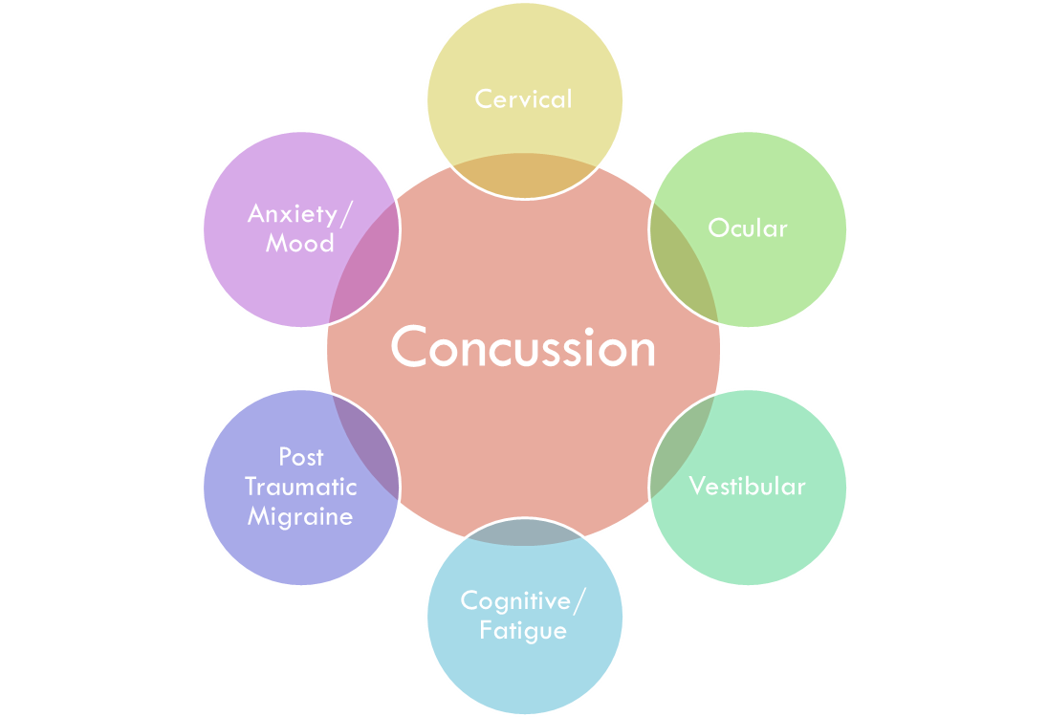
SUBTYPES
Adopted from UPMC

Slide 18
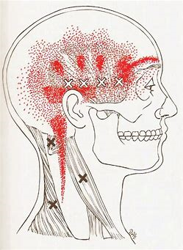
CERVICAL PROFILE
NECK pain, stiffness, soreness
Headache, radiating from upper cervical spine forward
Precipitated/ aggravated by specific neck movements or sustained postures
High Velocity trauma (eg: MVA)
Unprepared for Hit
Strong Rotational component to injury
Balance

Slide 19
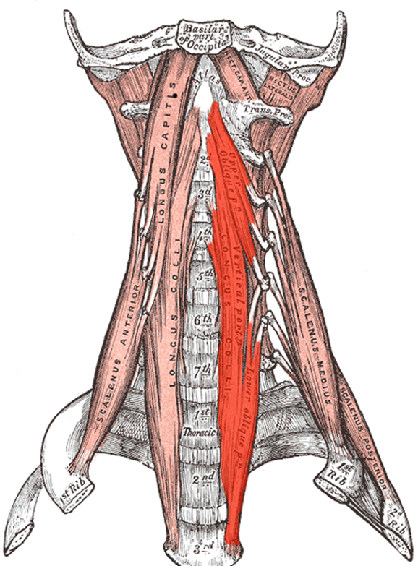
Cervical Measures
Neck Disability Index (NDI)
Functional Cervical Motion
Functional Strength Testing
Craniocervical Flexion Test
Craniocervical flexion Maneuver
Joint Position Error Test
Cervical extension
Deep neck Flexor Test
Postural Alignment
Headache Disabiltiy Index (25 items)

Slide 20
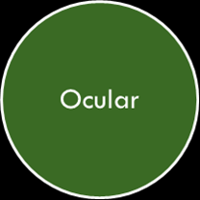
OCULAR/ VISUAL PROFILE
Frontal headaches w/ visual work
Difficulties with visually based classes and activity
Pressure behind the eyes
Visual “focus” issues
Blurry vision
Double vision
Balance

Slide 21
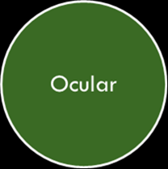
Ocular/ Visual Measures
VOMS
Smooth pursuits
Horizontal and Vertical Saccades
Convergence
Horizontal VOR
Vertical VOR
Visual Motion Sensitivity Test
COVER TEST / UNCOVER TEST
Testing for misalignment during binocular function
Mucha et al, 2014

Slide 22
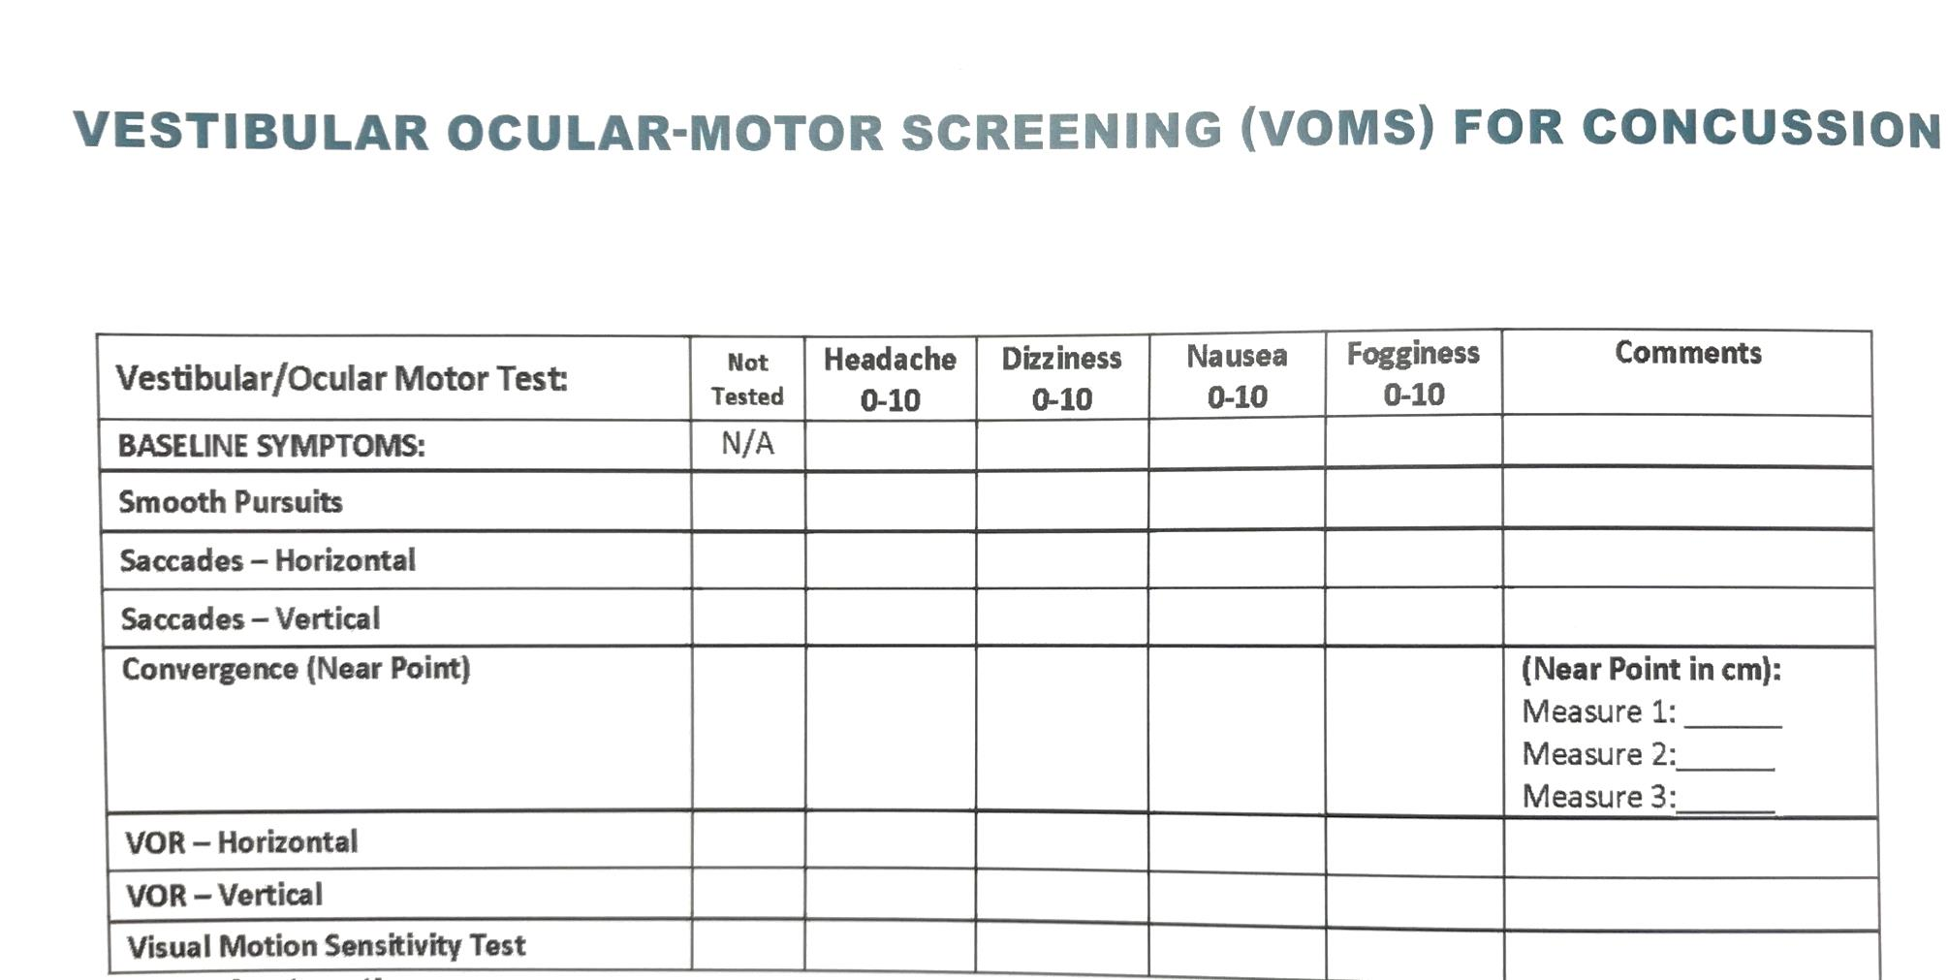
VOMS

Slide 23
VESTIBULAR PROFILE
Vestibular
Dizziness
Nausea/ Motion sickness
“one step behind”
Symptomatic in busy environments
Off balance
NOT AS COMMON IN THE PEDIATRIC POPULATION

Slide 24
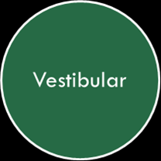
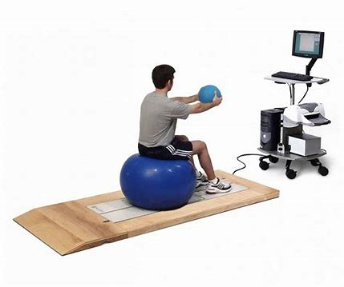
VESTIBULAR Measurement/ BALANCE
Balance
BESS
Clinical Test of sensory interaction and balance (CTSIB)
SOT/ HSSOT
DGI
Functional Gait Assessment
Activities Specific Balance Confidence Scale (ABC)
Dix- Hallpike Test
BPPV
Nystagmus
VOR IMPAIRMENT
Head impulse Test
Clinical dynamic Acuity Test

Slide 25
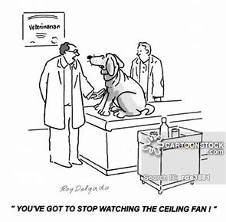
PT CERVICAL TREATMENT
ROM
Joint Mobilization
STM
Postural education
Functional strengthening

Slide 26
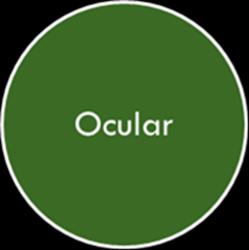
PT Ocular TREATMENT
Convergence Exercises
Pencil Push ups
Brock Sprint
3-D dot card
Eye Movement Control
Eye Focusing and coordination
Eye Teaming and improving binocular Function
Accommodation
Advance program from Static, to Dynamic then multi tasking when appropriate

Slide 27
Summary
Concussions are VERY Common across all ages of kids
Most concussions resolve within 10 days when treated properly
Seek more care if symptoms persist past 10 days
504 plans are needed for R2P and R2L
Encourage safe play and safe places
CDC has training resources for health care professionals, families, and coaches
Contact us for a consultation as needed

Slide 28
Flow Chart for Concussion Clinic
Team meeting
Evaluations
MD
Hx & P
Imaging- testing
PT
Vestibular - balance
Ocular- motor
PSY
Mood
Psychosocial
Referrals
Muscular-skeletal
Cognitive
R2P
504 plan
Vision
Neurology
Alternative
Neuropsych
Psychiatry
R2L
MD
PT
Psy
Recommendations – R2P, R2L, 504plan, treatment

Slide 29
TEAM WORK
Physician
Neurologist
Primary care Sports Medicine
Pediatrician
Physical Medicine and Rehabilitation
Emergency Medicine
Rehabilitation
Athletic Trainers
Speech Therapist
Occupational Therapist
Neuropsychologist
Rehab Psychologist
Psychiatrist
Vision Specialist

Slide 30
Treatment planning
Concussion
School RN
School Teachers
Family
Friends
Diet
Exercise
Rest
Medication
Other
Therapies

Slide 31
ONLINE RESOURCES

Slide 32
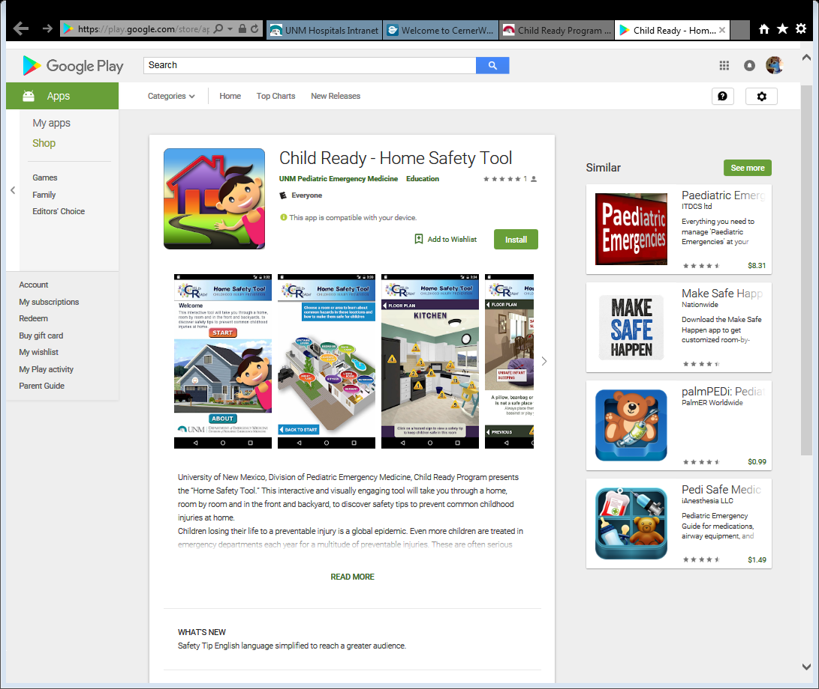
Resources

Slide 34
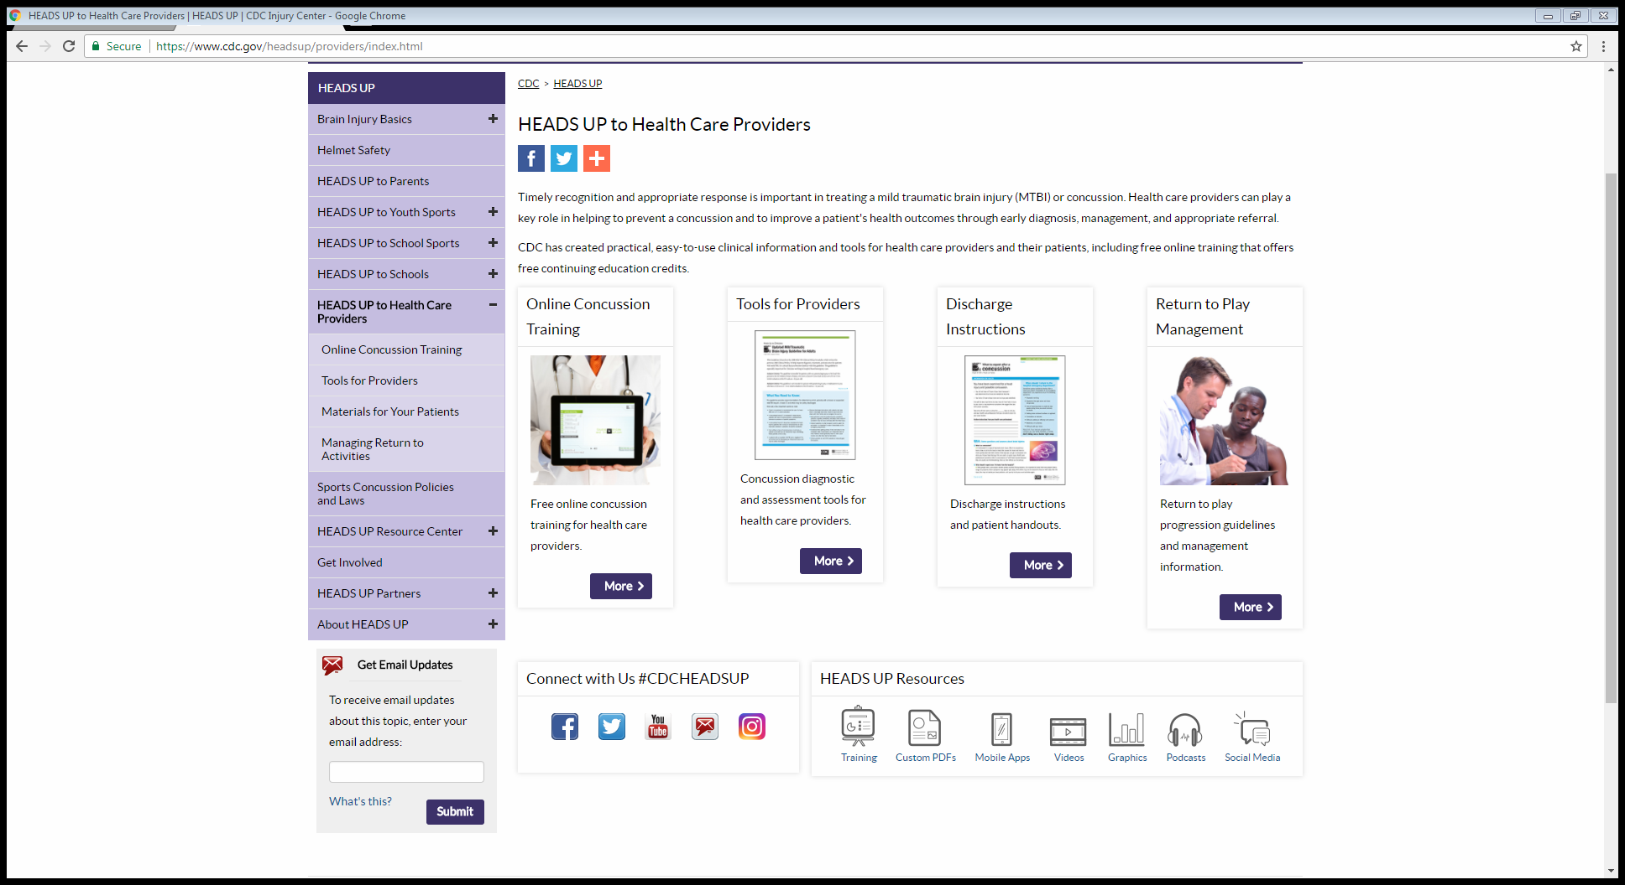

Slide 35
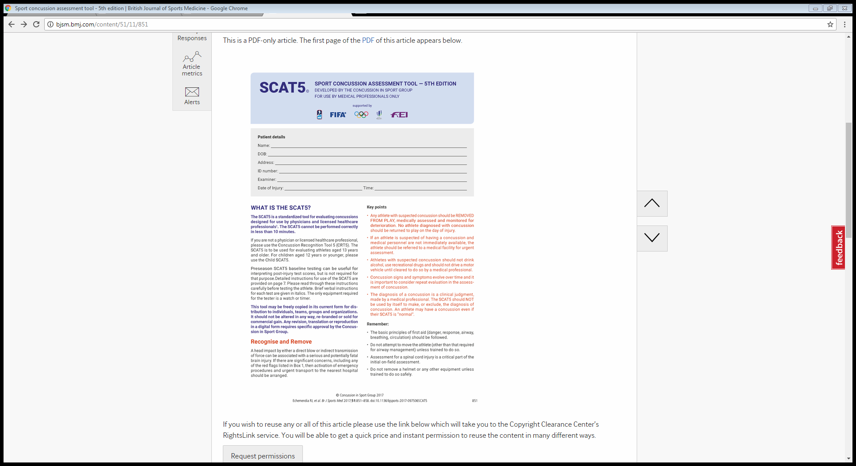

Slide 36
